Slide 1
Breast Cancer Diagnostic
Supervised learning

Slide 2
Project description
Goal: Breast Cancer Diagnosis
Dataset from University of California Irvine Machine Learning Repository: Wisconsin Diagnostic Breast Cancer
Dataset was gained from a digitized image of fine needle aspirate of a breast mass. The features are characteristics of the cell nuclei on the image (radius, texture, smoothness, etc.)
There are 10 features computed for all cell nuclei + mean, extreme and std. error of each features = 30 real-valued features
Data might need normalization to put everything on the same scale, also features need to be labeled

Slide 3
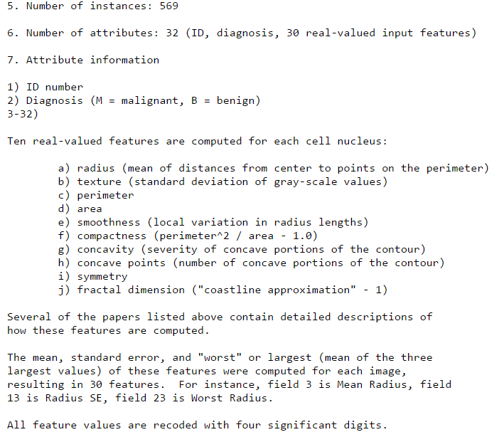

Slide 4
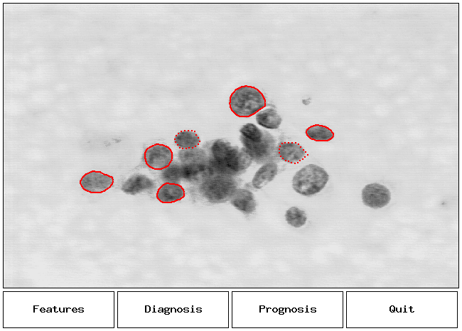

Slide 5
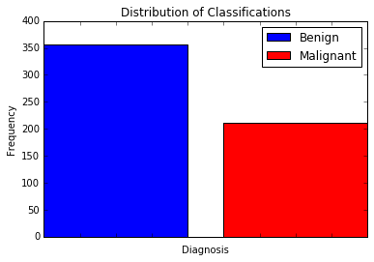

Slide 6
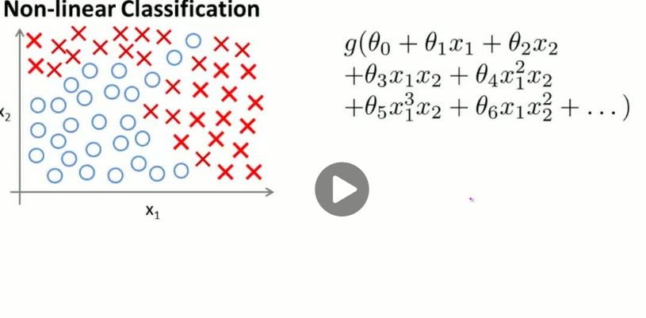

Slide 7
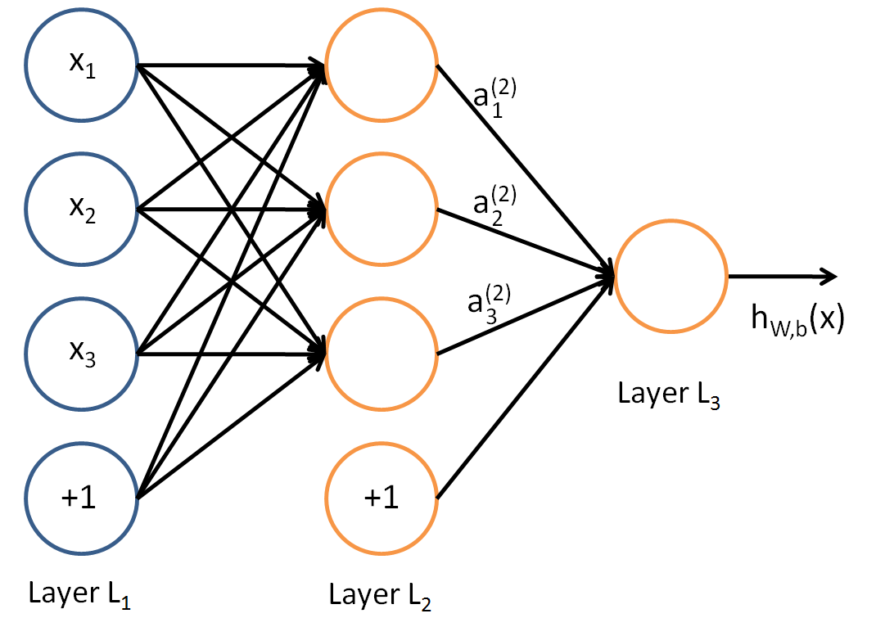
Two Content Layout with Table
 | Group A | Group B
Class 1 | 82 | 85
Class 2 | 76 | 88
Class 3 | 84 | 90
First bullet point here
Second bullet point here
Third bullet point here

Slide 8
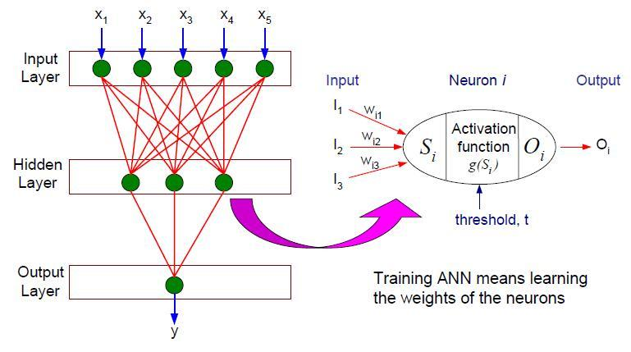
Group A
Task 1
Task 2
Group B
Task 1
Task 2
Group C
Task 1

Slide 9
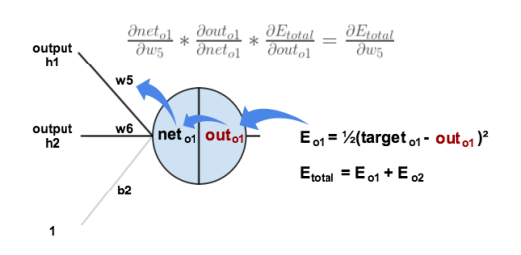
How to train a neural network
https://mattmazur.com/2015/03/17/a-step-by-step-backpropagation-example/

